Slide 1

Hyperparameter tuning
Tuning process
deeplearning.ai

Slide 2
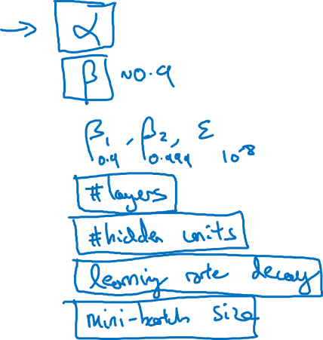
Hyperparameters

Slide 3
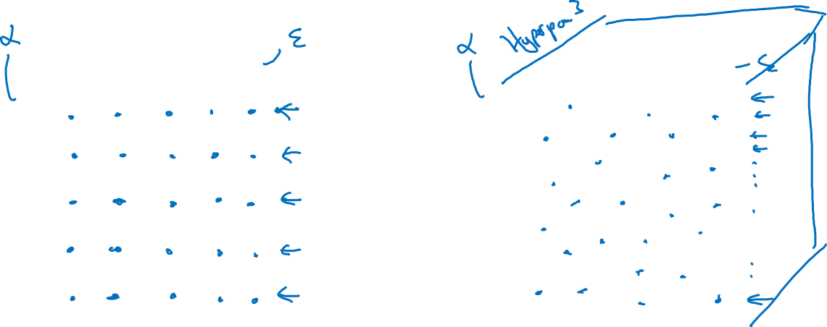
Try random values: Don’t use a grid
Hyperparameter 2
Hyperparameter 2
Hyperparameter 1
Hyperparameter 1

Slide 4
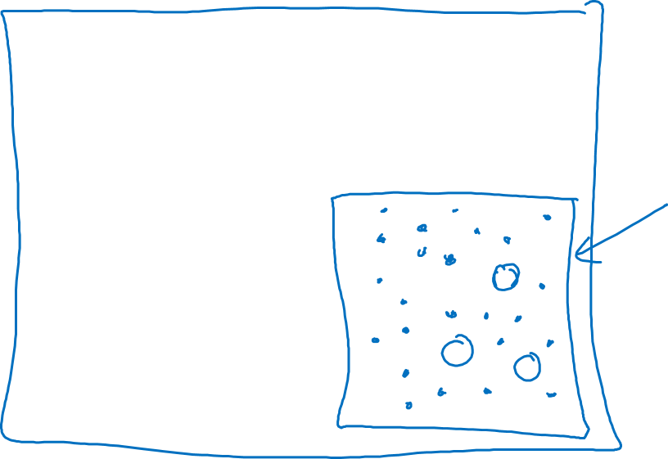
Coarse to fine
Hyperparameter 2
Hyperparameter 1

Slide 5
Hyperparameter tuning
Using an appropriate scale to pick hyperparameters
deeplearning.ai

Slide 6
Picking hyperparameters at random

Slide 7
Appropriate scale for hyperparameters

Slide 8
Hyperparameters for exponentially weighted averages

Slide 9
Hyperparameters tuning
Hyperparameters
tuning in practice:
Pandas vs. Caviar
deeplearning.ai

Slide 10

Re-test hyperparameters occasionally
Idea
NLP, Vision, Speech,
Ads, logistics, ….
Intuitions do get stale. Re-evaluate occasionally.
Experiment
Code

Slide 11
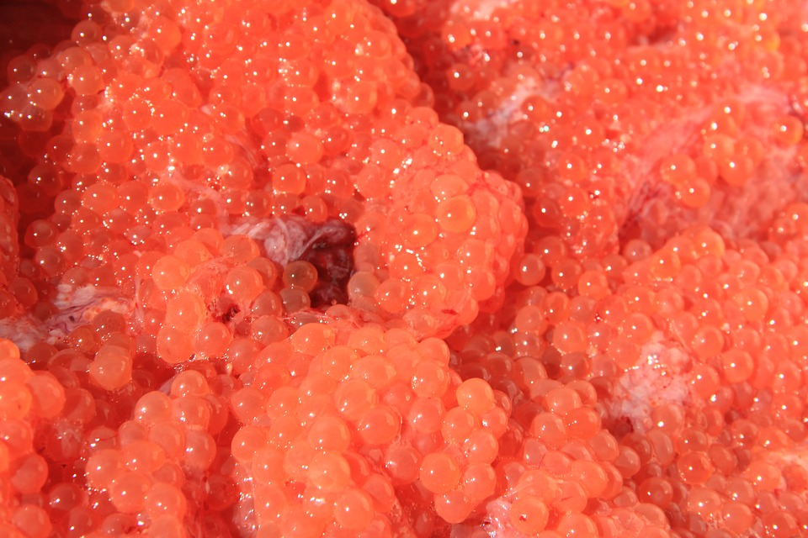
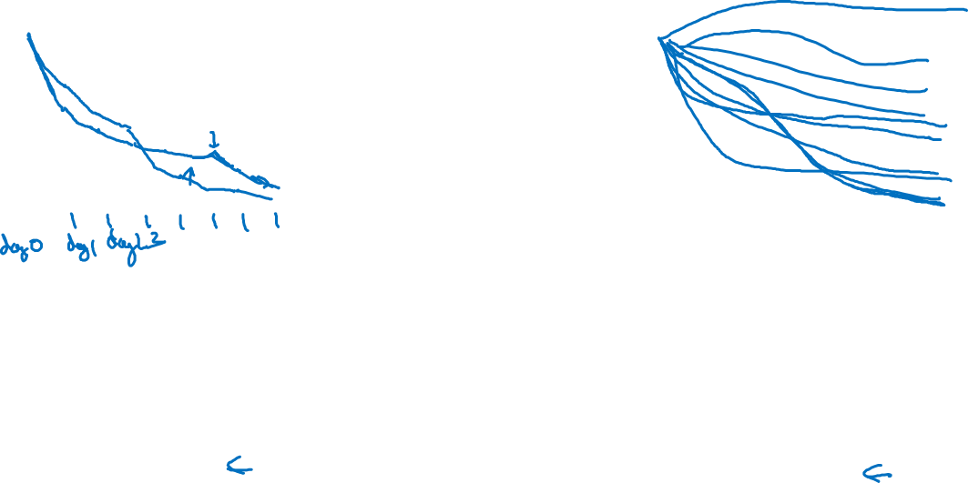
Babysitting one model
Training many models in parallel
Panda
Caviar

Slide 12
Batch Normalization
Normalizing activations
in a network
deeplearning.ai

Slide 13
Normalizing inputs to speed up learning
$$x_{1}$$
$$w,b$$
$$x_{2}$$
$$\hat{y}$$
$$x_{3}$$
$$x_{1}$$
$$x_{2}$$
$$\hat{y}$$
$$x_{3}$$

Slide 14
Implementing Batch Norm

Slide 15
Batch Normalization
Fitting Batch Norm
into a neural network
deeplearning.ai

Slide 16
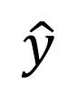
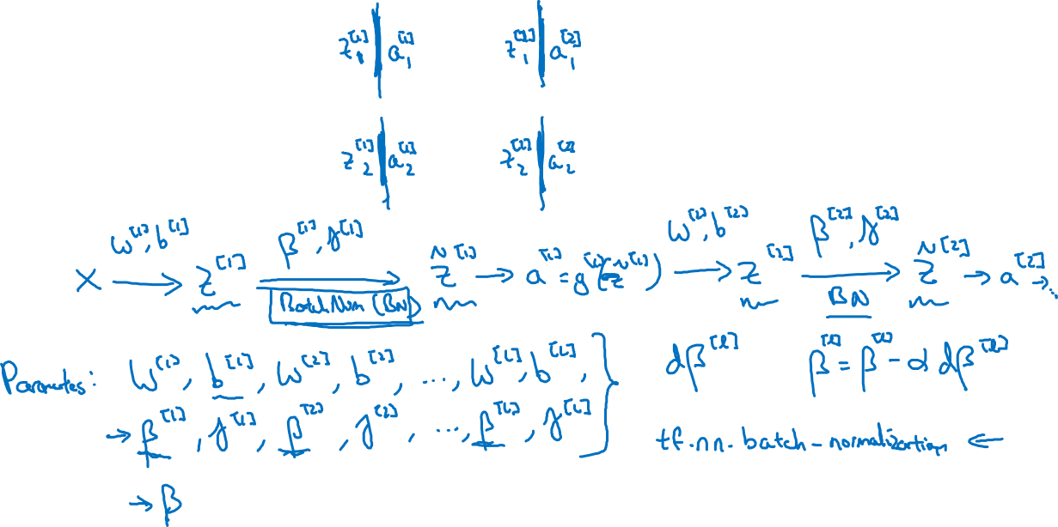
Adding Batch Norm to a network
$$x_{1}$$
$$x_{2}$$
$$\hat{y}$$
$$x_{3}$$

Slide 17
Working with mini-batches

Slide 18
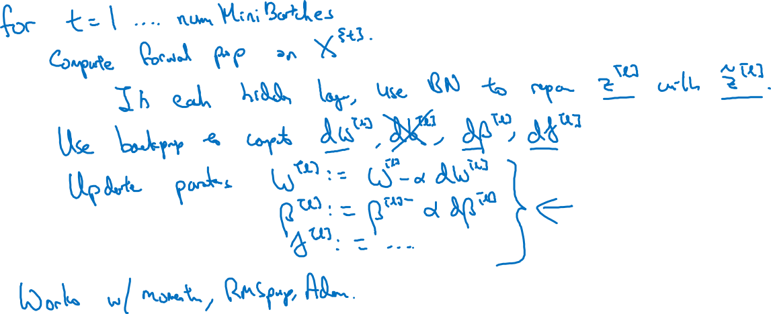
Implementing gradient descent

Slide 19
Batch Normalization
Why does
Batch Norm work?
deeplearning.ai

Slide 20
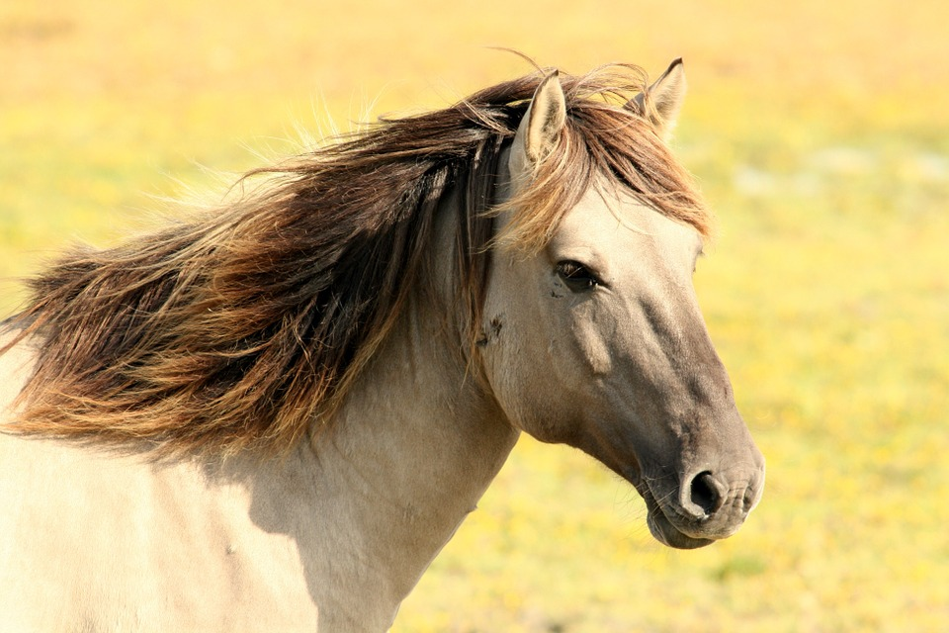
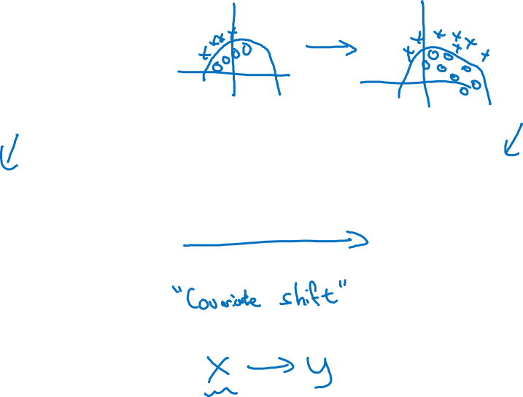
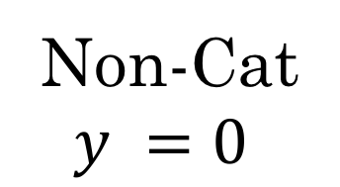
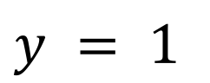
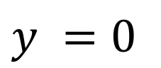
Learning on shifting input distribution
$$x_{1}$$
$$x_{2}$$
$$\hat{y}$$
$$x_{3}$$
Cat
$$y = 1$$
Non-Cat
$$y =0$$
$$y = 1$$
$$y =0$$

Slide 21
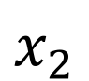
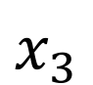
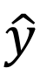
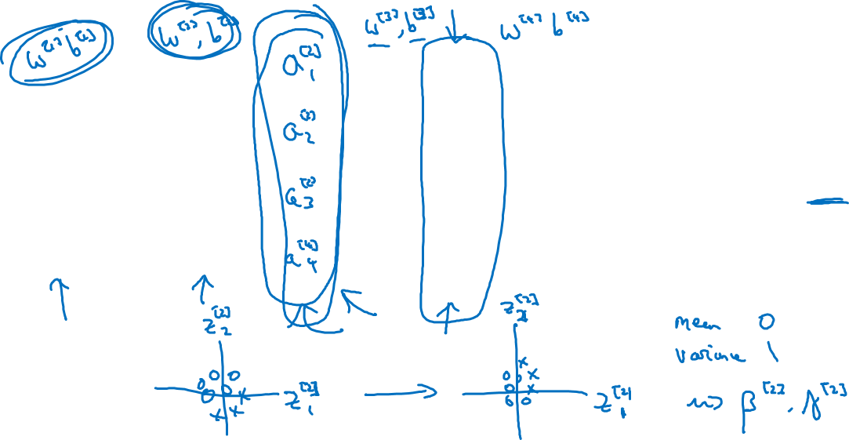
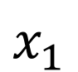
Why this is a problem with neural networks?
$$x_{1}$$
$$x_{2}$$
$$\hat{y}$$
$$x_{3}$$

Slide 22
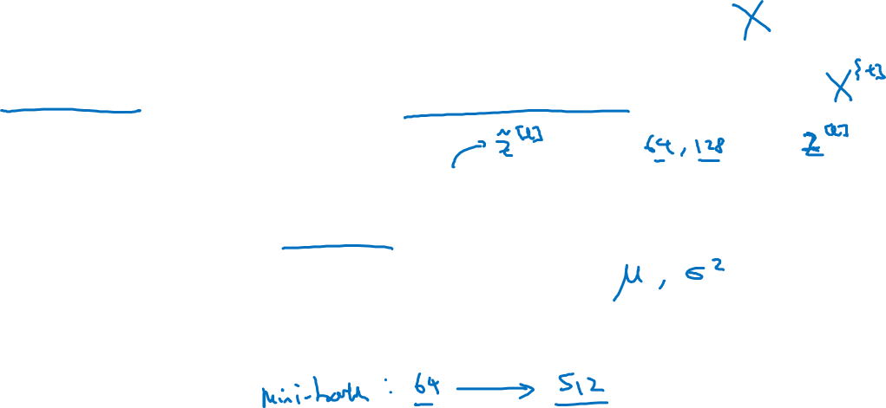
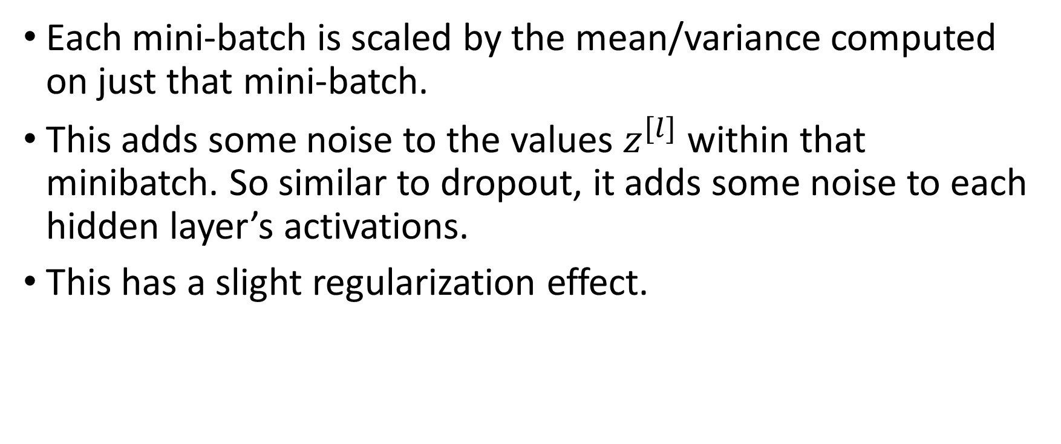
Batch Norm as regularization
Each mini-batch is scaled by the mean/variance computed on just that mini-batch.
This adds some noise to the values $z^{[l]}$ within that minibatch. So similar to dropout, it adds some noise to each hidden layer’s activations.
This has a slight regularization effect.

Slide 23
Batch Normalization
Batch Norm at
test time
deeplearning.ai

Slide 24
Batch Norm at test time
$$μ=\frac{1}{m}\sum_{i}{z^{(i)}}$$
$$σ^{2}=\frac{1}{m}\sum_{i}{{{(z}^{(i)}−μ)}^{2}}$$
$$z_{norm}^{(i)}=\frac{z^{(i)}−μ}{\sqrt{σ^{2}+ε}}$$
$${{\tilde{z}}^{(i)}=γz}_{norm}^{(i)}+β$$

